Slide 1
Lamp project
IOT Workshop

Slide 2
Requirements
Materials
Cables
3 resistor
1 NPN Transistor
1 DC-DC Voltage regulator (3.3v)
9 pinout
1 ESP-14
1 prototype shield
A Lamp
Tools
Protoboard
Multimeter
Programmer (CP1202 UART2TTL)
Soldering tip
Arduino IDE / ESP8266 Boards

Slide 3
Source code
https://github.com/rfrancoch/IoT-Relay

Slide 4
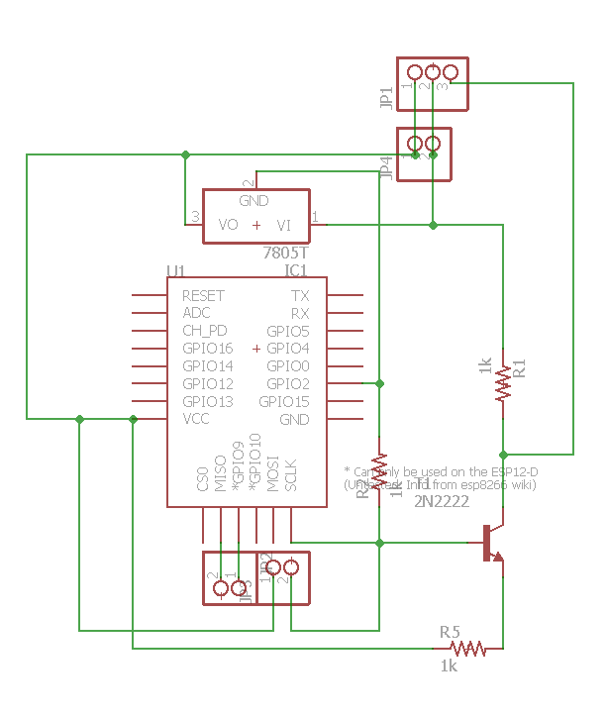
Schema

Slide 5
Prototyping
Wiring in the protoboard
Test your configuration
Solder the components in the board
Wire
Test
Solder

Slide 6
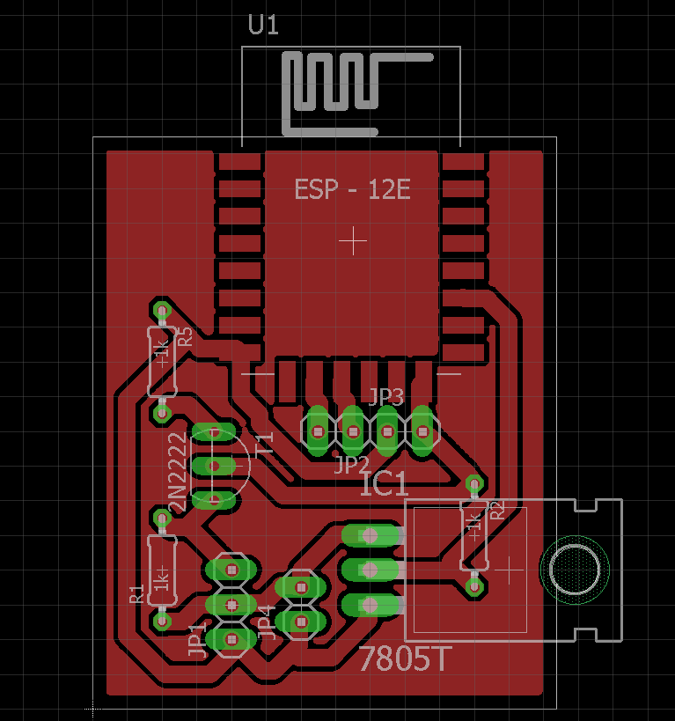
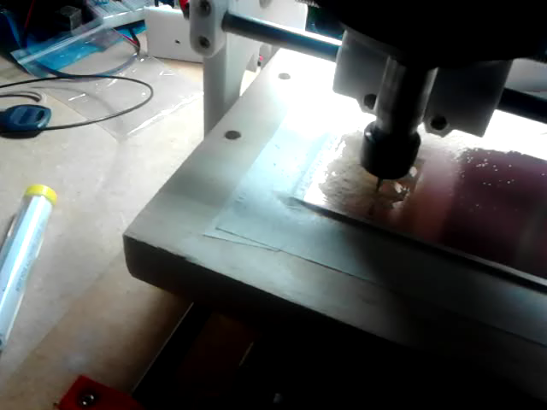
Board

Slide 7
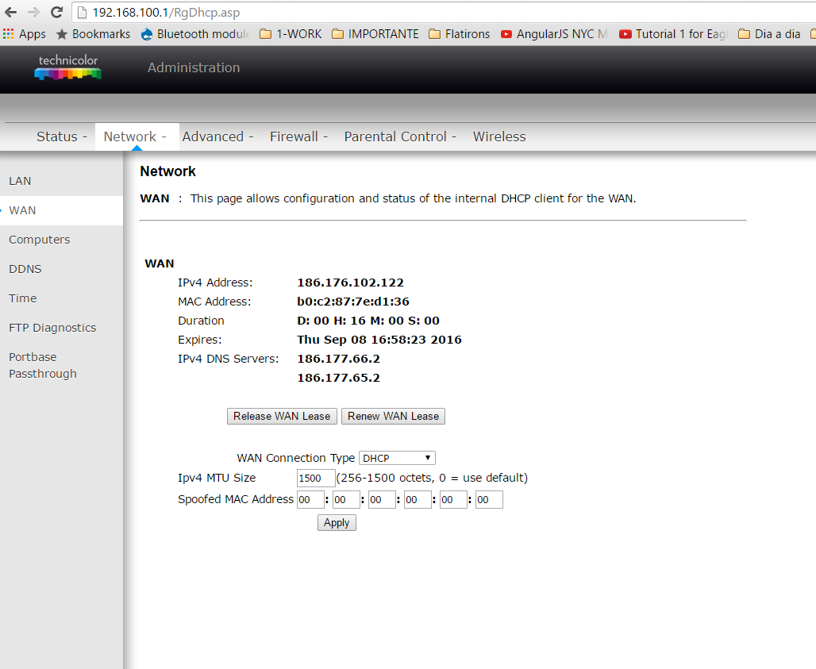

Slide 8
